Slide 1
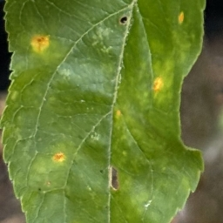

Cedar Apple Rust Image Classification
Evan Apinis

Slide 2
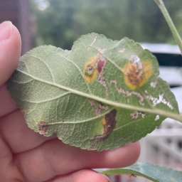
Problem Statement
Problem:
This past spring my apple trees showed diseased leaves
Having not grown apple trees before I was unsure of the specific disease type
Goal:
Train an ML model with diseased apple tree leaves to identify the disease type

Slide 3
Related Work
Researchers from Penn State used the PlantVillage dataset and an AlexNet and GoogLeNet model to achieve 99.35% testing set accuracy (includes apple leaves) [1]
Supervised and unsupervised models have been applied to identify plant diseases (does not include apple leaves) [2]
[1] Frontiers | Using Deep Learning for Image-Based Plant Disease Detection
[2] https://www.researchgate.net/publication/337023535_Plant_Disease_Identification_and_Classification_using_Image_Processing

Slide 4
Approach
Using the New Plant Diseases Dataset from Kaggle (87k images)
38 classes across 14 plant species including apple tree leaves and diseases
Predefined 80/20 split for training/testing datasets
Testing set is split for verification and testing 70/30
Improves data augmentation from PlantVillage dataset with rotation and backgrounds
Implementing ResNet-18 model for dataset to attempt to achieve high accuracy

Slide 5
ResNet-18 Model Configuration
Train and Test loaders transformed to 256x256 pixel images with 0.5 mean and 0.5 standard deviation
Default ResNet-18 model weights used
Batch sizes of 32 with ResNet-18 used ~6GB of VRAM
Model was moved to GPU with DirectML Torch library
The model was trained for ten epochs and used a verification dataset for each epoch for testing performance
Final accuracy testing was performed with an independent testing dataset unfamiliar to the model

Slide 6
Model Training Results
Epoch | Training Accuracy | Training Loss | Testing Accuracy | Testing Loss
1 | 93.70% | 0.3159 | 98.84% | 0.0443
2 | 99.11% | 0.0402 | 99.36% | 0.0241
3 | 99.59% | 0.0212 | 99.32% | 0.0219
4 | 99.75% | 0.0142 | 99.52% | 0.0165
5 | 99.85% | 0.0100 | 99.53% | 0.0143
6 | 99.90% | 0.0074 | 99.61% | 0.0126
7 | 99.95% | 0.0054 | 99.61% | 0.0123
8 | 99.96% | 0.0046 | 99.62% | 0.0121
9 | 99.97% | 0.0037 | 99.66% | 0.0119
10 | 99.97% | 0.0033 | 99.70% | 0.0109

Slide 7
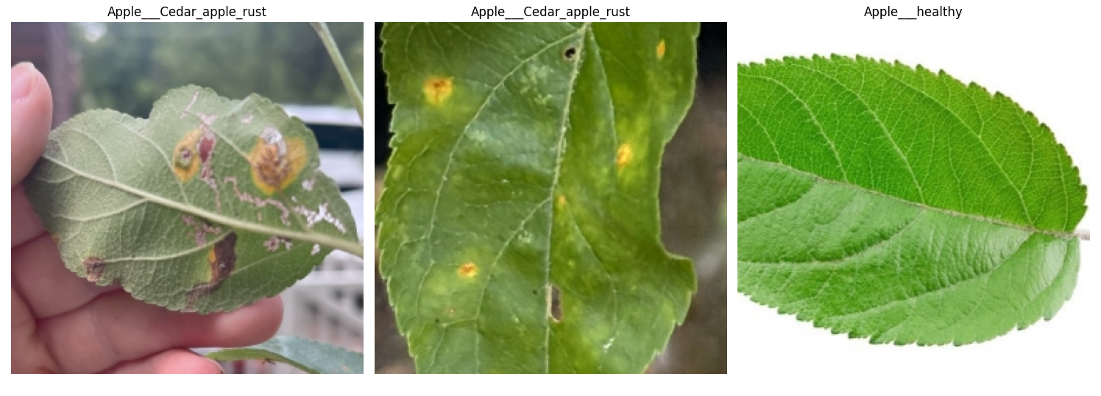
Classification Results
Provided the model with three images to classify
Two diseased leaves with their predicted label and a healthy stock image

Slide 8
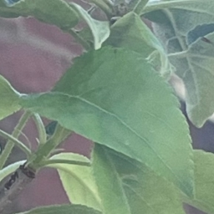
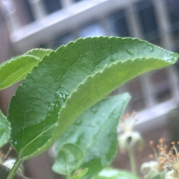
Misclassification Issues
Tomato Healthy
I attempted to predict the labels for two images I had of healthy leaves on my tree
Both images were incorrectly identified as healthy leaf variants of other plants
Blueberry Healthy

Slide 9
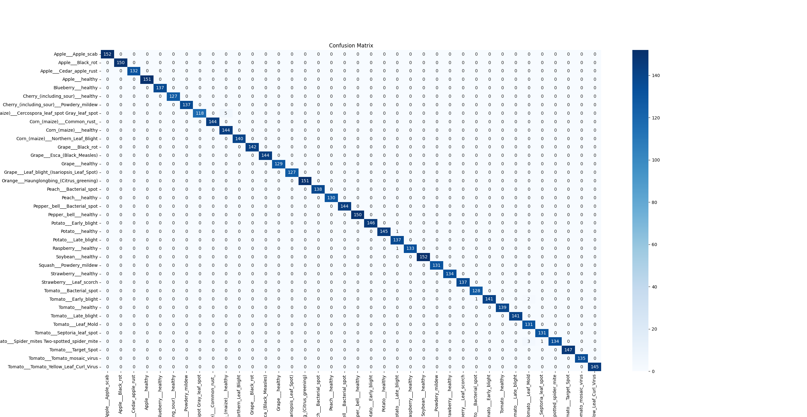
Confusion Matrix

Slide 10
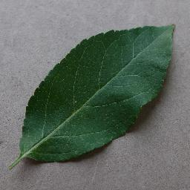
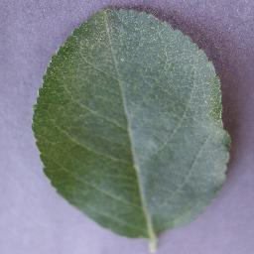
Classification Report + Training Images
Classification report again disputes my hypothesis about healthy leaf misclassification
Training images show that leaves used were flat
Quality of test images used likely contributed to misclassification
Leaf | Precision | Recall | F1-Score | Support
Apple Scab | 1.00 | 1.00 | 1.00 | 152
Apple Black Rot | 1.00 | 1.00 | 1.00 | 150
Cedar Apple Rust | 1.00 | 1.00 | 1.00 | 132
Apple Healthy | 1.00 | 1.00 | 1.00 | 151
Blueberry Healthy | 1.00 | 1.00 | 1.00 | 137
Tomato Healthy | 0.99 | 0.99 | 0.99 | 139

Slide 11
Conclusion
The model trained in this project achieved 99.70% accuracy, greater than the 99.35% accuracy from the related work section
The model was able to correctly identify the disease from images I had taken over the summer
From testing the healthy leaves, there is still room for improvement as the model may not have been trained with enough variation in training photos.

Slide 12
Code
Code for model training and testing can be found in GIT repo with dataset and images
https://github.com/apinise/Project_579.git

